Slide 1
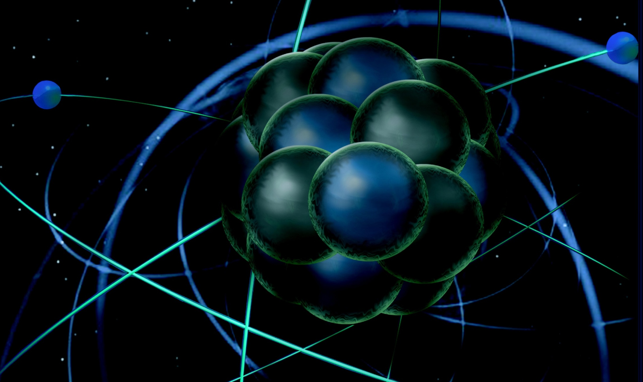
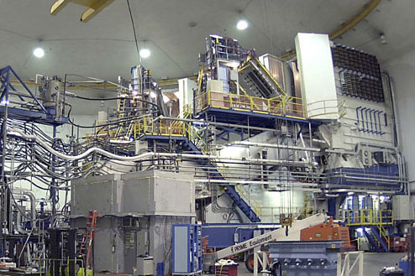
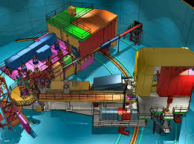
A Physics Career at a Laboratory
Thia Keppel
HUGS
June 2016

Slide 2
Let’s work backwards…
You’re a laboratory Leader – who are you looking for?
Someone with a skill to round out your team
Someone with breadth and/or promise to develop needed future skills
Someone who can get along in the department
Someone who can initiate research and attract collaborators
Someone who will make your department famous

Slide 3
Someone who can get along in the department
Communicate well
Work on listening and asking relevant questions as well as presenting your self and science (ball toss)
Be friendly, clear, professional, and collaborative
Don’t only talk about you, see above
Do a good job when you do talk about you (think about the strengths that you want to present), and don’t hesitate to self-promote a bit
Don’t assume they know about you
Laboratory: Develop a skill that is of great use that not many others can do as well as you, preferably cutting edge – and critically tied to ongoing hardware needs (alert! experimental bias! ☺)
Compton polarimetry
FPGA programming
Develop skills that are of general use – and offer them
In addition to my focus on x and y, I think that I can contribute to this department also by…
For experimentalists, significant hardware experience is always a major plus
“Someone with a skill to round out your team.”
There are also skill-specific groups and divisions, provides more opportunity (think JLab target, DAQ, detector,…. groups)

Slide 4
Someone who will make your department famous
Intangible, but try to be:
Original (read a lot of papers, get to know topics well, ask questions individually and in person, discuss with experts,…)
Don’t leave it up to someone else to guide you entirely or for the community to notice you
Be driven by the science – this is the fun part!
A Leader
Write papers
Take on high level responsibilities
Volunteer for tasks, committees,..
Dedicated
Likely long hours
Work beyond what you are asked and take on what makes scientific sense, not the minimum required
Help others, but you will need to budget your time
Physics fashion can be a pro and a con

Slide 5
Someone who can initiate research and attract collaborators
Leadership of a project
Spokesperson of an experiment
Heading a major construction effort
Patents
Longevity
Don’t want to be a one hit wonder – think a bit longer term
Breadth
Other applications or areas of interest?
Bottom line for laboratory:
Something to expand or round out scientific expertise/reach of group, attract or support users
Technical and intellectual leadership/responsibility

Slide 6
So, how do you get there?
Get to know the field, and the people in it
What is interesting to the community?
Seminars
Papers
Conferences
What is interesting to you?
What new facilities are being built?
New technology coming available? (theory too)
Where do the above match, and where are there opportunities that you can champion moving forward?
Seek a postdoc that fits the answer to this, talk to the people working in this area way in advance
Maybe even contribute to their efforts before hired to do so (as possible)
Be proactive
– Don’t just wait to see what’s around and join
Don’t assume your famous advisor or institution will see you thru

Slide 7
So, how do you get there?
Work hard and do very well in all that is assigned to you
Communicate with your supervisor and group, be a helpful member
Try to effectively go above and beyond, but be careful of your time not to spread too thin
Find something to lead – try and be original with this, but OK to ask for guidance and ideas
Go to conferences, meetings, seminars – talk, ask
Talk (even via e-mail) to experts in an area you are trying to break into, are interested in
[personal example, CTEQ]
It has to be genuine.
If you’re not really interested and not thinking deeply it will show.
You’re choosing to do this for your career – should be of great interest to you (and fun) to spend this level of time and effort

Slide 8
Network
You are always on an interview. You never know!
[personal stories as example]
HUGS
Thesis
Human nature to be comfortable with the known
Join, volunteer, attend, talk, ask – be active, get to know and be known.

Slide 9
Back to you (the Chair) …
Any position is a serious financial commitment on the part of an institution
Before you posted it, something strong motivated it
Try to find out what that is and perhaps speak to it. Could be…
Specialty area group (think JLab target/DAQ/detector/etc.) wanting to either round out their expertise or perhaps expand their “services”
what are they doing now? (know this!)
General nuclear physics group (think JLab Physics staff) wanting to perhaps strengthen an area of expertise or expand their general capabilities nurturing someone new
what are they doing now? (know this!)
May have had to overcome opposition to open or keep position
Want candidate that will justify you going to battle for the position.. i.e. they want you to shine – help them with this!

Slide 10
They went through a lot to post the position…
Don’t put too many requirements on the department from the start
Two body issues
Startup requirements
Distance experiments,…
Get them interested in you and your science first, give them something to rally around, support and pitch to their department, Division, and up
If they are enthusiastic they will help with your concerns, but they need to be enthusiastic first

Slide 11
Your talk
What makes a good Seminar?
Cool physics
Right level! The audience will know a lot, but will also want to see that you know a lot – but don’t be too simple, very tricky!
Organization and flow
Clarity (don’t use yellow, no clutter – same goes for your words!)
Wow factor – nice graphics, movie, pictures, humor, props,…
But, it is physics…serious business, not too much wow and all wow should be on topic ☺
Basics – dress well, speak loudly, look at people, move about, pay attention to your audience
If you can bring in something the institution did and link it without too much of a stretch that’s great
Definitely bring in something that you did and make your contribution clear
Practice and accept criticism from experts, but work with more than one expert (do physicists ever agree?! ☺)

Slide 12
…and don’t run over time!
Thanks for your attention!

